Slide 1

MICA team:
Mike Jackson, Inder Grang, Chris Conner , Abby Kannappan
NFL Quarterback Analysis

Slide 2
Questions:
Does drafting a quarterback high in the draft provide teams a better chance at success?
How do stats compare amongst them and do they make a difference to success?
What are the costs and what is the overall value?
Is there a definitive draft strategy teams should utilize?

Slide 3
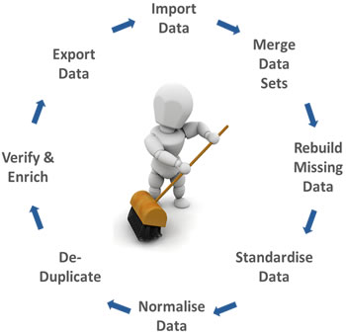
Presentation Outline
Data Sources and Cleansing
Data Evaluation of draft data
Draft round data vs NFL performance metrics
NFL performance statistics vs. Player Salary
Data Outliers
Conclusions

Slide 4
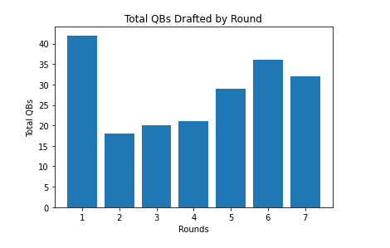
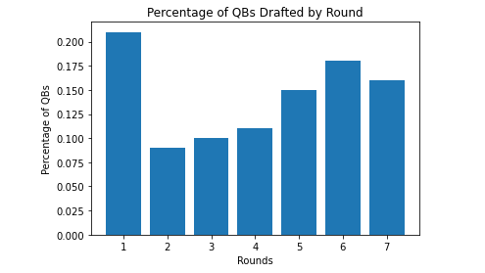
QBs Drafted from 2000 to 2015
198 drafted in our study

Slide 5
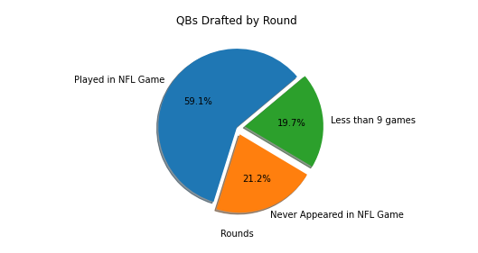
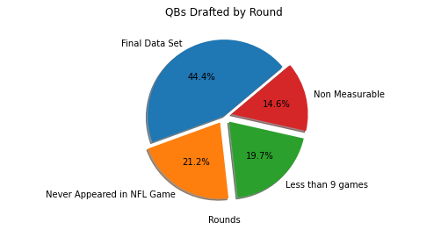
Data Cleanup-Elimination of Non Measurables or Insufficient Data
88 Relevant QBs

Slide 6
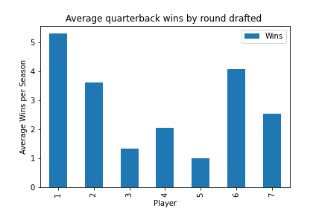
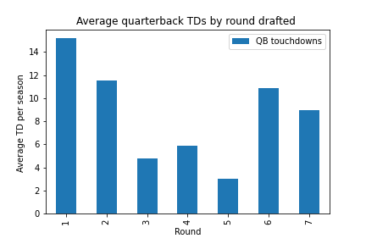
Wins and TDs

Slide 7
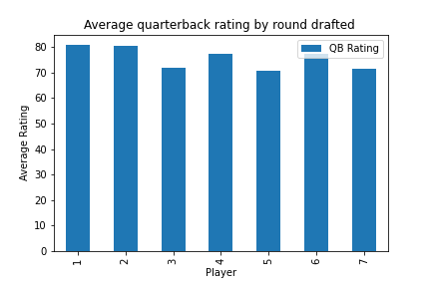
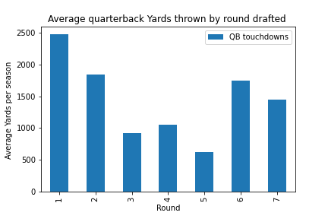
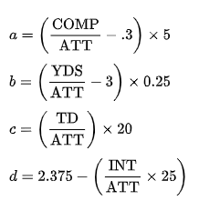
QB Rating and Yards
Formula for QB rating

Slide 8
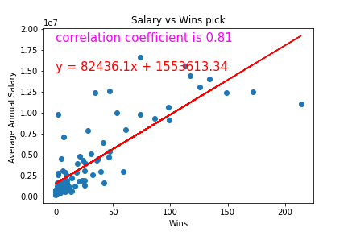
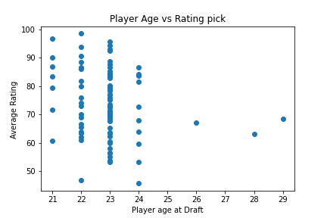
Draft Analysis
Here is a linear regression of salary vs number of wins
Correlation coefficient is 0.81 which means strong Correlation
Most of the players got picked at age 22 or 23.

Slide 9
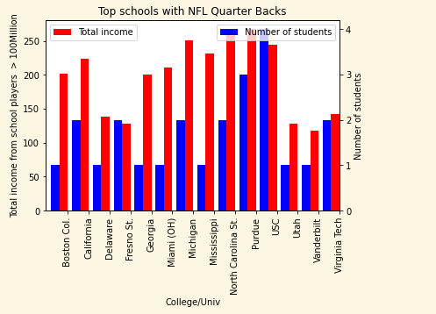
Data Analysis (Colleges/Univ)
USC had the most QB players at 4
Most of the schools only had 1 player

Slide 10
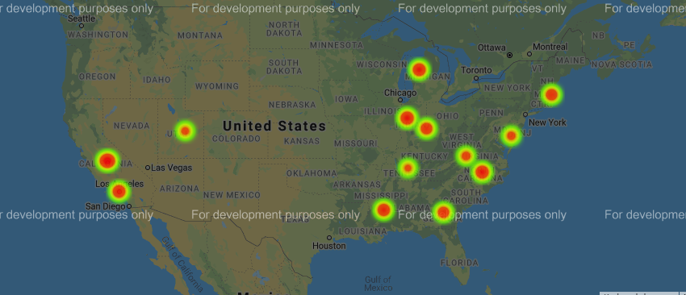
Universities by Player Salaries
Here is a heat plot of geolocations of different univ (weighted by their players’ salaries)

Slide 11
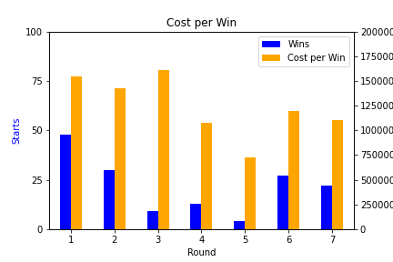
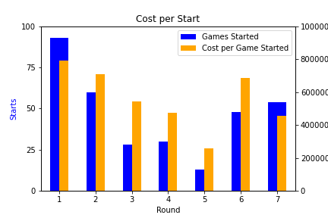
First rounders average 48 wins at a cost of $1.5M per “W”
…and approximately 88 games started at $800K/game

Slide 12
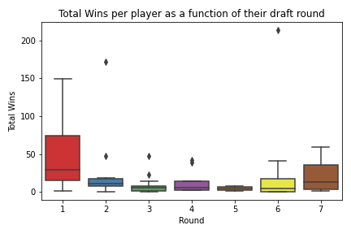
Do outliers make things more clear?

Slide 13

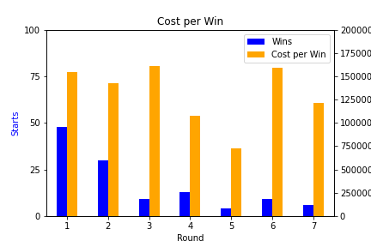
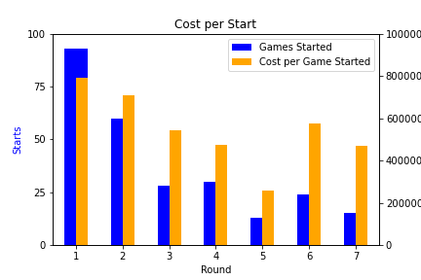
Without “The Goat”
(and his two outlier buddies)

Slide 14
Conclusions
Can’t definitively say which round provides the absolute most value, but there is a clear talent gap drop after round 2.
Whether the motivation is Winning or simply Games Started, there is very little money saved by passing on a first rounder.
Rounds 3-5 provide extremely low value and should be avoided. The odds of finding a “Unicorn” in rounds 6 & 7 are just as likely.

